Slide 1
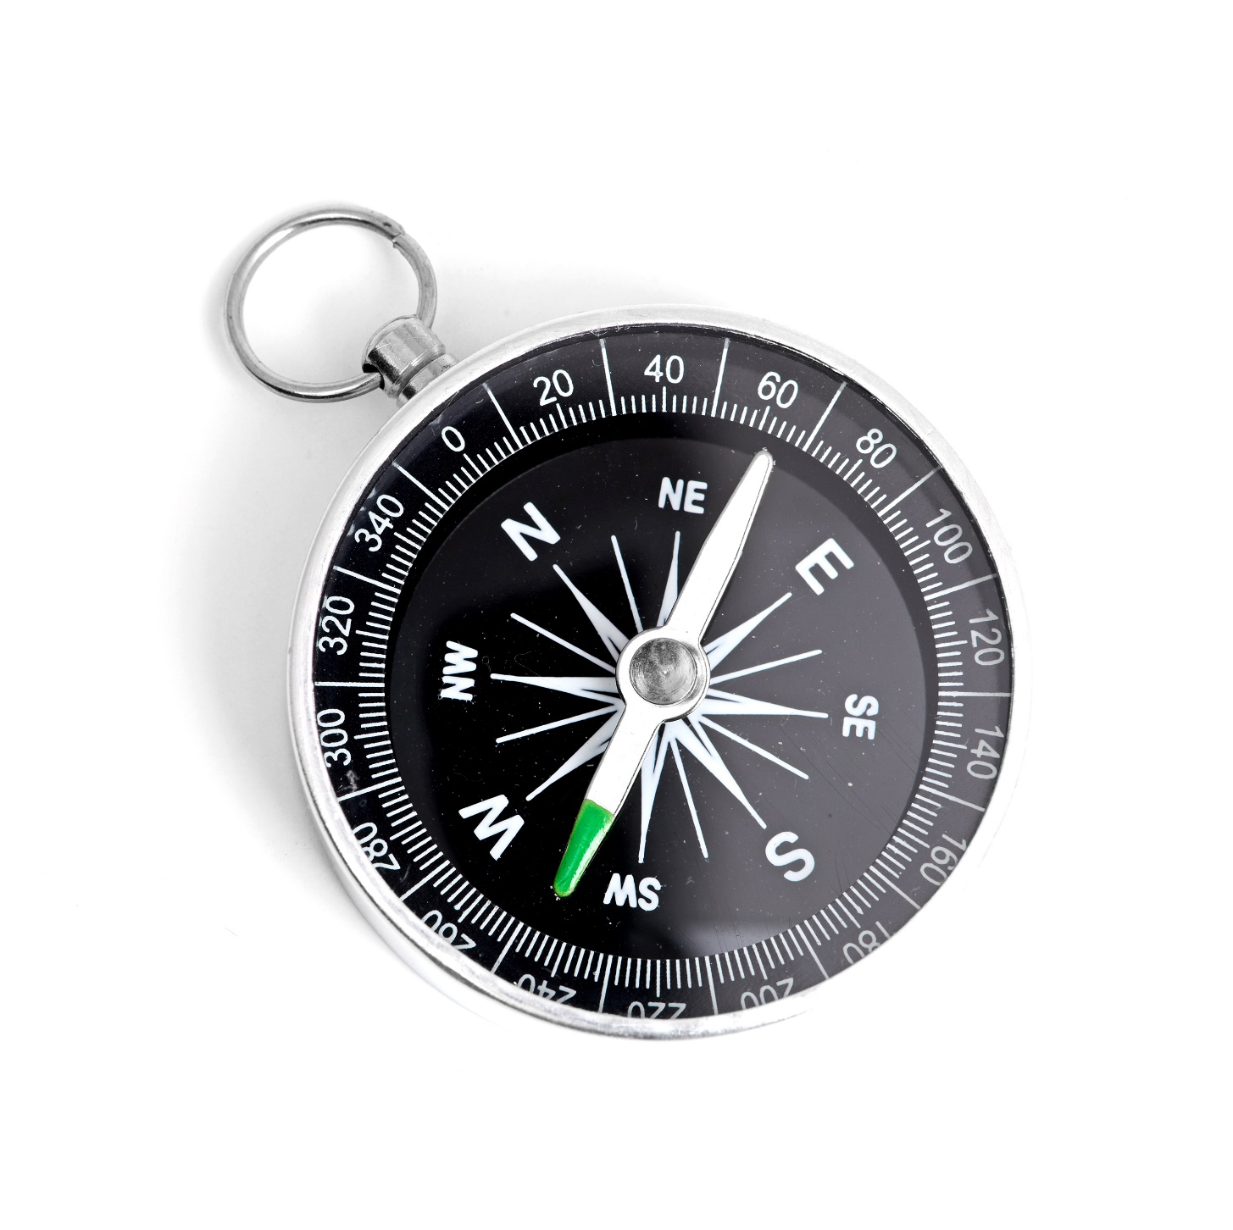
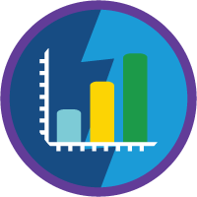
Reports and Dashboards
July 29TH, 2021

Slide 2


Know Your Trainer!
I am an Industrial Engineer
Prior to Salesforce, I worked on Capital Machinery
Associated with Deloitte since 2018
Based in Bengaluru
Recently bought a RE Himalayan!
‘The Office’ is my favorite show!

Slide 3

Just one rule - Don’t be like Stanley!

Slide 4

Let’s convert the business requirements into visual representations.

Slide 5
Contents
1
2
3
What are Reports and Dashboards
Understanding the Basics
Use Case
4
5
Requirements documentation
Trailheads

Slide 6
Reports
What are Report Types?
Report Format
A report type is like a template that makes reporting easier.
The report type determines which fields and records are available for use when creating a report.
Tabular Reports: Similar to a spreadsheet, they consist simply of an ordered set of fields in columns, with each matching record listed in a row.
Summary Reports: Summary reports are similar to tabular reports, but also allow you to group rows of data, view subtotals, and create charts.
Matrix Reports: Matrix reports allow you to group records both by row and by column. These reports are the most time-consuming to set up, but they also provide the most detailed view of our data.
A report is a list of records that meet the criteria you define.
It’s displayed in Salesforce in rows and columns, and can be filtered, grouped, or displayed in a graphical chart.
Where do we store reports?
How do we share reports?
Every report is stored in a folder.
Folders can be public, hidden, or shared, and can be set to read-only or read/write.
You control who has access to the contents of the folder based on roles, permissions, public groups, and license types.
Folder Sharing in Salesforce allows you to restrict access to reports and dashboards by users, roles, roles and their subordinates, territories, territories and their subordinates, and public and private groups
With enhanced folder sharing, you can control who sees what. Each user, group, territory, or role can have its own level of access to a single report and dashboard folder.

Slide 7
QUIZ!!
Can an admin decide to not share the report with anyone? How can the admin do that?

Slide 8



Dashboards
What are Dashboard Components?
Examples of Components
Salesforce dashboards allow you to present multiple reports side-by-side using dashboard components on a single dashboard page layout.
Dashboard components come in a variety of chart types, and you can customize how data is grouped, summarized, and displayed for each component
Salesforce dashboards allow you to present multiple reports side-by-side using dashboard components on a single dashboard page layout.
Dashboard components come in a variety of chart types, and you can customize how data is grouped, summarized, and displayed for each component.
Pie Chart
Gauge
Table
What are Dashboard filters?
The magic of Dynamic Dashboards
Dashboard filters make it easy to provide different combinations of data from a single dashboard. You don’t need separate dashboards for different sets of users — just give each group a filter that makes sense for them.
With dynamic dashboards, each user sees the data they have access to without needing to create separate dashboards for each user.
This means a single powerful dashboard can be used for multiple users in your company, because the logged-in user viewing the dashboard sees the data they should see, based on their security and sharing settings.

Slide 9
QUIZ!!
The admin of Dunder Mifflin is tasked with creating a dashboard to show data from a single user’s perspective. What type of dashboard should the admin create?

Slide 10
Dunder Mifflin Company
Dashboard for Monthly Sales and Marketing Meeting
Michael Scott, the regional manager of Dunder Mifflin Scranton branch holds a monthly meeting with the Sales and the marketing team where he reviews the data related to Sales. With the new Salesforce instance installed he is hoping to look at the data in an enhanced manner. He is tasking Jim with creating the Dashboard which can be reviewed by everyone. He is strictly asked to share the reports and dashboard with Andy Bernard. No one else within the Sales team should have access to them. Michael is curious to know how many new clients have been onboarded by the entire Sales team till date so that he can study the pipeline. With a goal to evaluate each Salesperson individually, he also wants to view their individual performance. For this, he would need to know how many clients are currently in the pipeline and its worth.
Dunder Mifflin also carries out marketing campaigns and Michael also wants to understand how many leads are being generated and what are the associated sources with it. An indicator that affects the Sales teams performance is also the number of leads converted into Opportunities. Michael would like to see that on the report as well.

Slide 11
Dunder Mifflin Company
Requirements
Create a dashboard and name it ‘Dunder Mifflin Sales Dashboard’
Share it with Andrew Bernard – Create a folder for Andrew Bernard and give him a manage access
Leads Report with sources
Leads converted to Opportunities
How many new clients are onboard till date
Create a report with Opportunities closed/won by owner and add it to a dashboard
Opportunity pipeline Report

Slide 12
Reports and Dashboards for Lightning Experience
Click here
Quick Start: Reports and Dashboards
Let’s Practice some Trailheads
Click here
For Sales and Marketing Managers
Click here
For Salesforce Classic
Click here
Filter Report Data
Click here
Salesforce Einstein
Click here

